Slide 1
Object Oriented Programming
Week 8
Email: abeer.gauher@nu.edu.pk
Office: CS BASEMENT 2, Office number 23

Slide 2
Contents
Abstract Classes
Abstract Methods
Interfaces

Slide 3
Abstraction
Abstraction is a process of hiding the implementation details and showing only functionality to the user
Abstraction lets you focus on what the object does instead of how it does it
There are two ways to achieve abstraction in java
Abstract class (0 to 100%)
Interface (100%)

Slide 4
Abstract Classes and Methods
In the inheritance hierarchy, classes become more specific and concrete with each new subclass
from a subclass back up to a superclass, the classes become more general and less specific
Sometimes a superclass is so abstract that it cannot have any specific instances
an abstract class: determines the nature of the methods that the subclasses must implement

Slide 5
Abstract Classes
An abstract class cannot be instantiated, but other classes are derived from it.
An Abstract class serves as a superclass for other classes.
The abstract class represents the generic or abstract form of all the classes that are derived from it.
A class becomes abstract when you place the abstract key word in the class definition.
public abstract class ClassName

Slide 6
Abstract Classes and Methods
Abstract class is declared with abstract keyword
It can have abstract and non-abstract methods
Abstract Method contains no implementation, i.e. no body.
Abstract Method is created to force same name and signature pattern in all the subclasses
Subclasses have the flexibility to code these methods with their own specific requirements
An abstract method cannot be contained in a nonabstract class

Slide 7
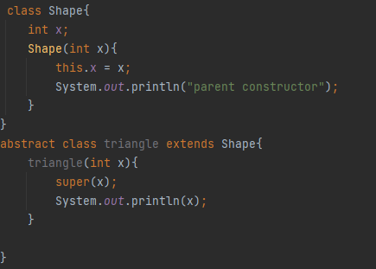
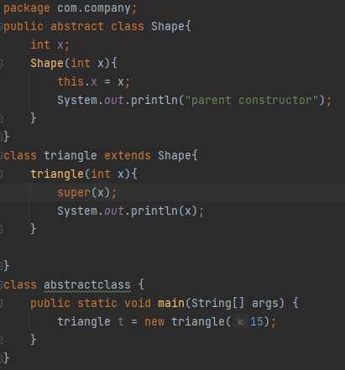

Abstract Classes and Methods
Abstract classes can extend other non abstract classes.
Abstract classes have constructors to initialize their own members (variables).
It is not necessary that abstract classes have abstract methods.

Slide 8
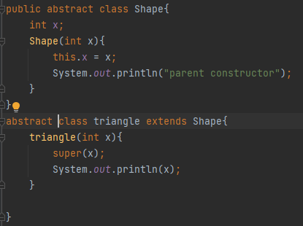
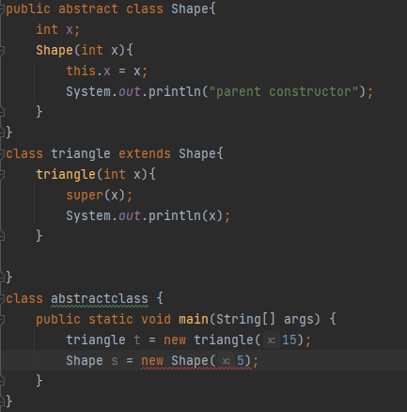

Abstract Classes and Methods
Abstract classes cannot be instantiated(cannot create objects of abstract class).
Abstract classes can extend other abstract classes.

Slide 9
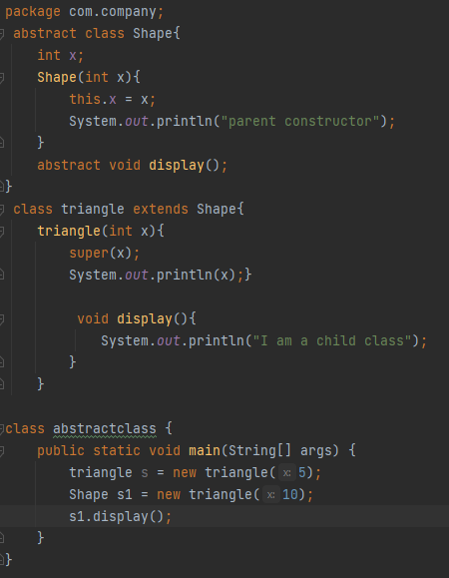
Abstract Classes and Methods
Abstract classes cannot be instantiated(cannot create objects of abstract class).
Can create reference of the abstract class.

Slide 10

Abstract Classes and Methods
abstract class GraphicObject {
int x, y;
...
void moveTo(int newX, int newY) {
...
}
abstract void draw();
abstract void resize();
}
When an abstract class is subclassed, the subclass usually provides implementations for all of the abstract methods in its parent class
class Circle extends GraphicObject {
void draw() {
...
}
void resize() {
...
}
}
class Rectangle extends GraphicObject {
void draw() {
...
}
void resize() {
...
}
}

Slide 11
Abstract Classes and Methods
If a subclass of an abstract superclass does not implement all the abstract methods, the subclass must be defined abstract
An abstract class cannot be instantiated using the new operator, but it may contain constructors, which are invoked in the constructors of its subclasses
A class that contains abstract methods must be abstract. However, it is possible to define an abstract class that contains no abstract methods.
A subclass can be abstract even if its superclass is concrete. For example, the Object class is concrete, but its subclasses, such as GeometricObject, may be abstract.
A subclass can override a method from its superclass to define it abstract
You cannot create an instance from an abstract class using the new operator, but an abstract class can be used as a data type

Slide 12
Abstract Methods
An abstract method has no body and must be overridden in a subclass.
An abstract method is a method that appears in a superclass, but expects to be overridden in a subclass.
An abstract method has only a header and no body.
AccessSpecifier abstract ReturnType MethodName(ParameterList);

Slide 13
Abstract Methods
Notice that the key word abstract appears in the header, and that the header ends with a semicolon.
public abstract void setValue(int value);
Any class that contains an abstract method is automatically abstract.
If a subclass fails to override an abstract method, a compiler error will result.
Abstract methods are used to ensure that a subclass implements the method.

Slide 14
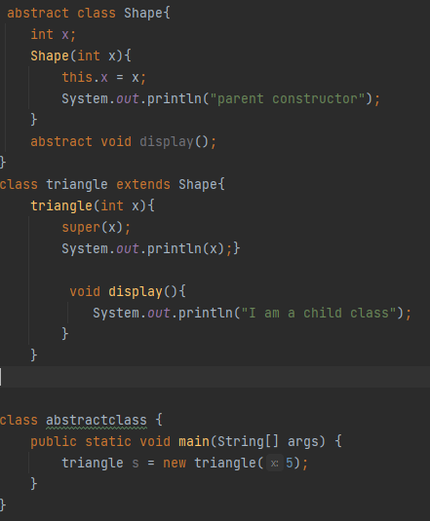
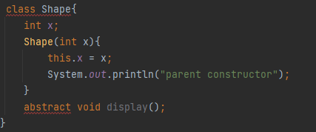
Abstract Methods
Abstract methods have no body.
Cannot create abstract methods in non abstract classes.
Must override all abstract methods in the child class.

Slide 15
Interfaces
Class that contains only constants and abstract methods
an interface is similar to an abstract class, but its intent is to specify common behavior for objects
modifier interface InterfaceName {
/** Constant declarations */
/** Method signatures */
}
public interface Stack{
public abstract void push(int item);
public abstract void pop();
}

Slide 16
Interfaces
Can not create instance from an interface using the new operator
Can be used as a data type for a reference variable
A constant defined in an interface can be accessed using the syntax InterfaceName. CONSTANT_NAME
All data fields are public final static and all methods are public abstract in an interface, Java allows these modifiers to be omitted.

Slide 17
Interfaces
The general format of an interface definition:
public interface InterfaceName
{
(Method headers...)
}
All methods specified by an interface are public by default.
A class can implement one or more interfaces.
It is necessary to override all the functions in the class implementing the interfaces, otherwise we have to make the class abstract.

Slide 18
Interfaces
If a class implements an interface, it uses the implements keyword in the class header.
public class FinalExam3 extends GradedActivity implements Relatable
Interfaces can have implementation of functions with “private” and “static” keyword but without abstract keyword.

Slide 19
Fields in Interfaces
An interface can contain field declarations:
all fields in an interface are treated as final and static.
Because they automatically become final, you must provide an initialization value.
public interface Doable
{
int FIELD1 = 1, FIELD2 = 2;
(Method headers...)
}
In this interface, FIELD1 and FIELD2 are final static int variables.
Any class that implements this interface has access to these variables.

Slide 20
Implementing Multiple Interfaces
A class can be derived from only one superclass.
Java allows a class to implement multiple interfaces.
When a class implements multiple interfaces, it must provide the methods specified by all of them.
To specify multiple interfaces in a class definition, simply list the names of the interfaces, separated by commas, after the implements key word.
public class MyClass implements Interface1,
Interface2,
Interface3

Slide 21
Extending Interfaces
An interface can inherit other interfaces using the extends keyword
public NewInterface Interface1, ..., InterfaceN {
// constants and abstract methods
}
A class implementing NewInterface must implement the abstract methods defined in NewInterface, Interface1, …. and InterfaceN
An interface can extend other interfaces but not classes.
A class can extend its superclass and implement multiple interfaces.

Slide 22
Interfaces vs Abstract Classes

Slide 23
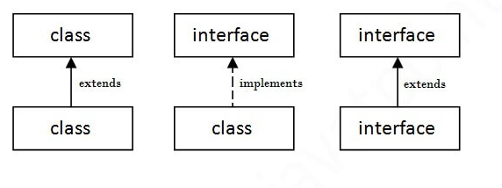
Interfaces in UML
GradedActivity
A dashed line with an arrow indicates implementation of an interface.
FinalExam3
Relatable

Slide 24
Polymorphism with Interfaces
Java allows you to create reference variables of an interface type.
An interface reference variable can reference any object that implements that interface, regardless of its class type.
This is another example of polymorphism.

Slide 25
Polymorphism with Interfaces
A reference to an interface can point to any class that implements that interface.
You cannot create an instance of an interface.
RetailItem item = new RetailItem(); // ERROR!
When an interface variable references an object:
only the methods declared in the interface are available,
explicit type casting is required to access the other methods of an object referenced by an interface reference.

Slide 26
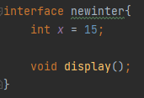
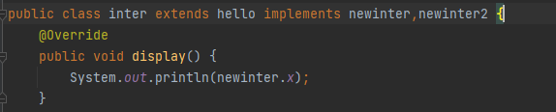

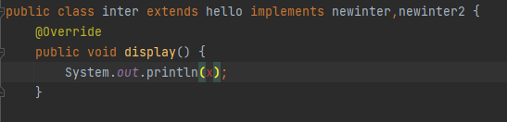
Examples
Can be resolved explicitly through class name

Slide 27
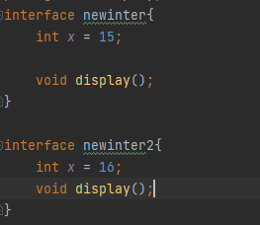
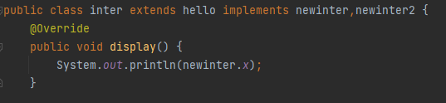
Examples
Advantage of interface is that it resolves ambiguity.
Two interfaces can have the same methods but while implementing only of those methods needs to be overridden.
While implementing the overridden methods needs to have access specifier as “public”.

Slide 28
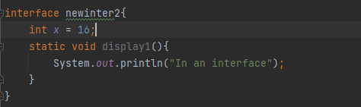

Examples
Static methods can be made in interfaces.
Variables values cannot be changed as they are final.

